Slide 1

Meeting a National Objective with CDBG
City of Orlando February 2026

Slide 2
CDBG requires activities to meet at least one of the three National Objectives:
Benefit Low and Moderate Income (LMI) Persons – Must benefit at least 51% LMI residents in an area or a specific group of LMI individuals
Eliminate Slum or Blight – Area basis or spot basis
Meet Urgent Need – Immediate threat to community

Slide 3
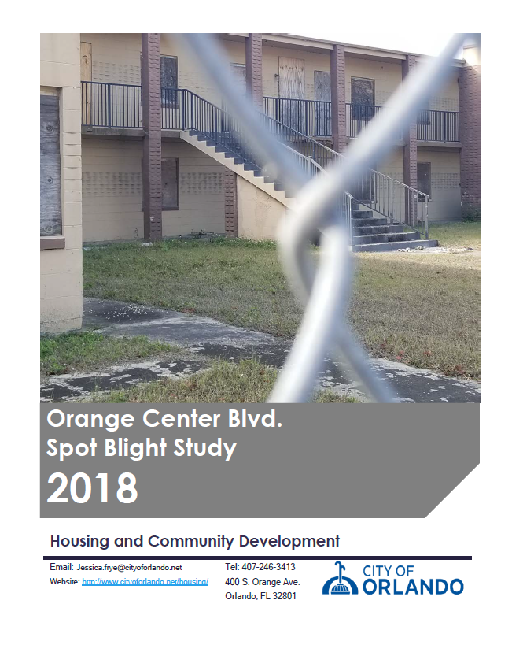
Slum and Blight – National Objective

Slide 4
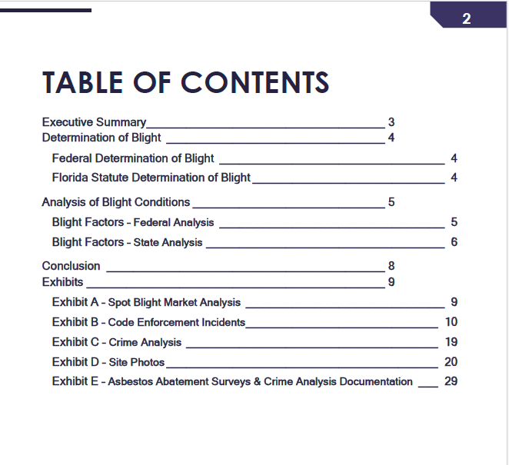
Slum and Blight – National Objective

Slide 5
Low/Mod Benefit for Multi-Year Certifications
If you anticipate using CDBG funds for slum/blight or urgent needs, aggregating multiple years may offer you flexibility in meeting the minimum 70 percent
You can meet your LMI minimum of 70 percent for a period of one (1) program year or aggregate use of CDBG funds for a period of up to three (3) specific consecutive program years

Slide 6
Low/Mod Benefit for Multi-Year Certifications
Use your “Specific Community Development Block Grant Certifications” in your Annual Action Plan to identify the program years you will use to meet the Overall Benefit of 70 percent LMI
Report the Program Years covered in your Certification in PR 26 IDIS Report – Line Item 23

Slide 7
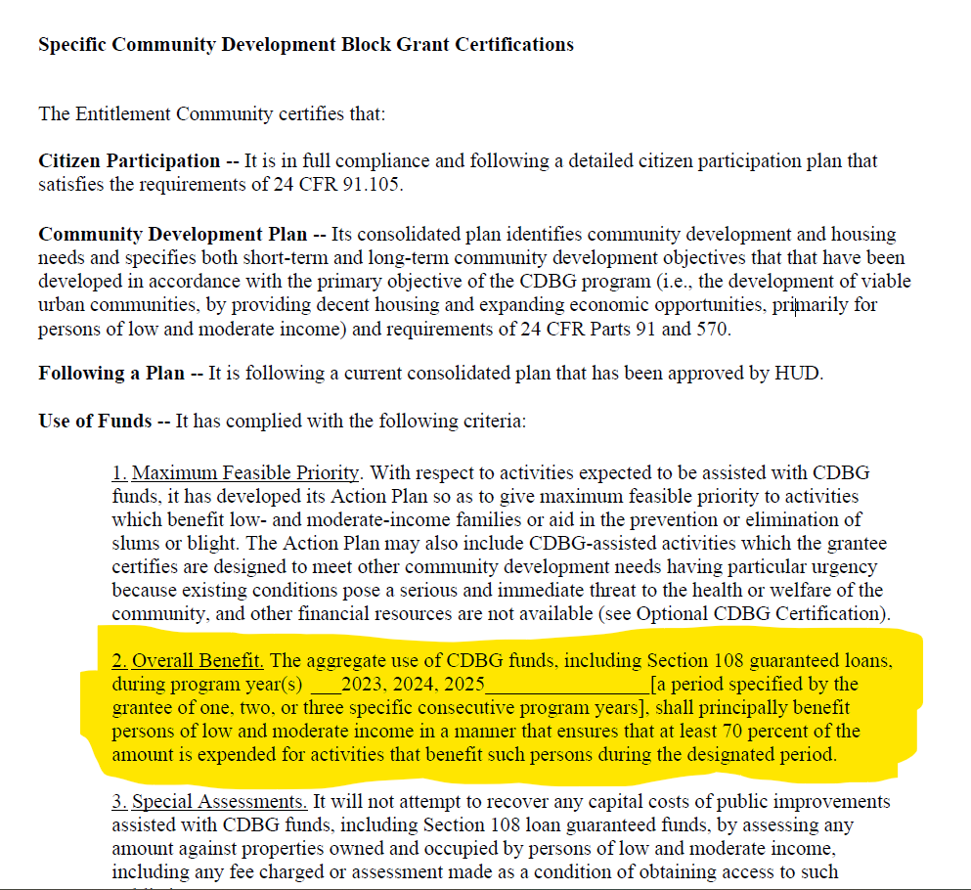
Annual Action Plan CDBG Certification

Slide 8
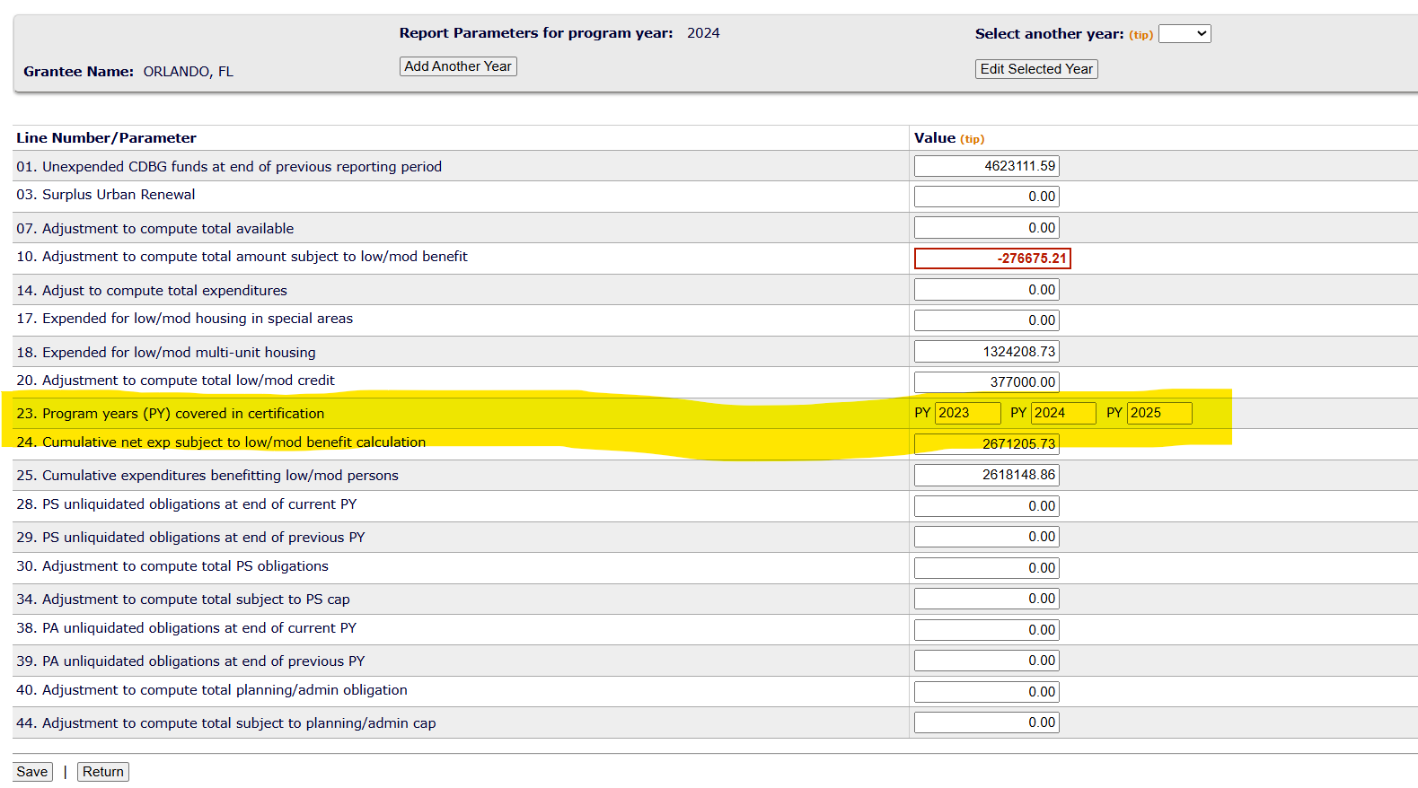
IDIS Report PR26

Slide 9
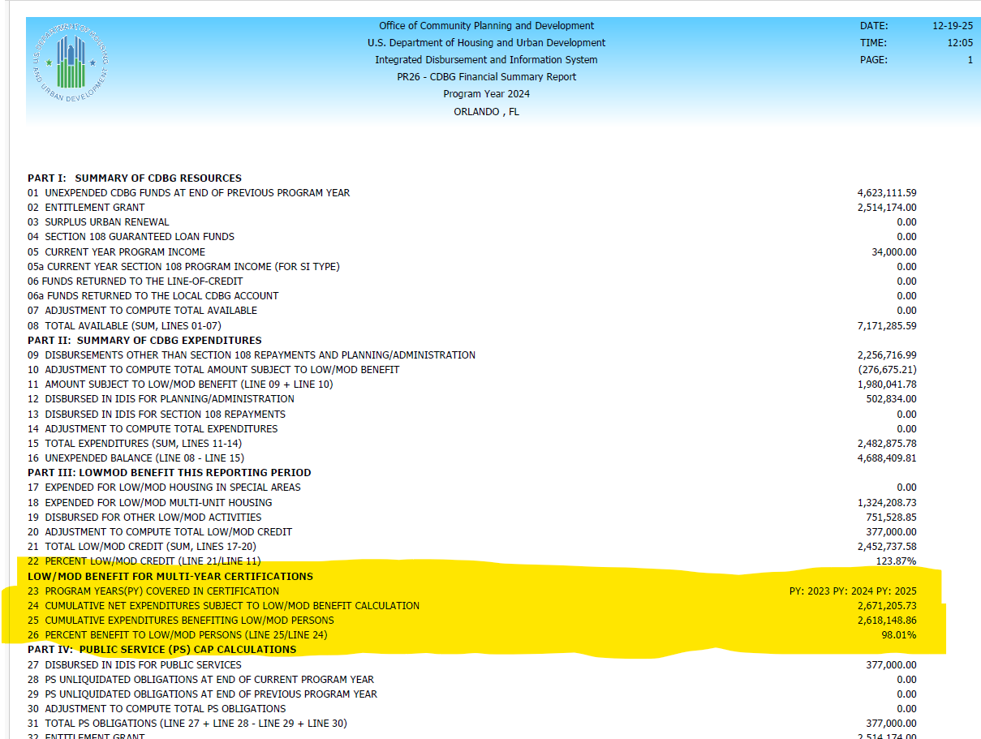
CAPER Low/Mod Benefit for Multi-Year Certifications

Slide 10
Limited Clientele – Presumed Benefit
Presumed Benefit – Abused children, elderly (62+), battered spouses, homeless persons, severely disabled adults, illiterate adults, persons living with AIDS, and migrant farm workers
Since these groups are presumed to be LMI, you do not need to collect individual income data
Nature/Location – It applies to services where the nature or location of the activity limits it to specific groups

Slide 11
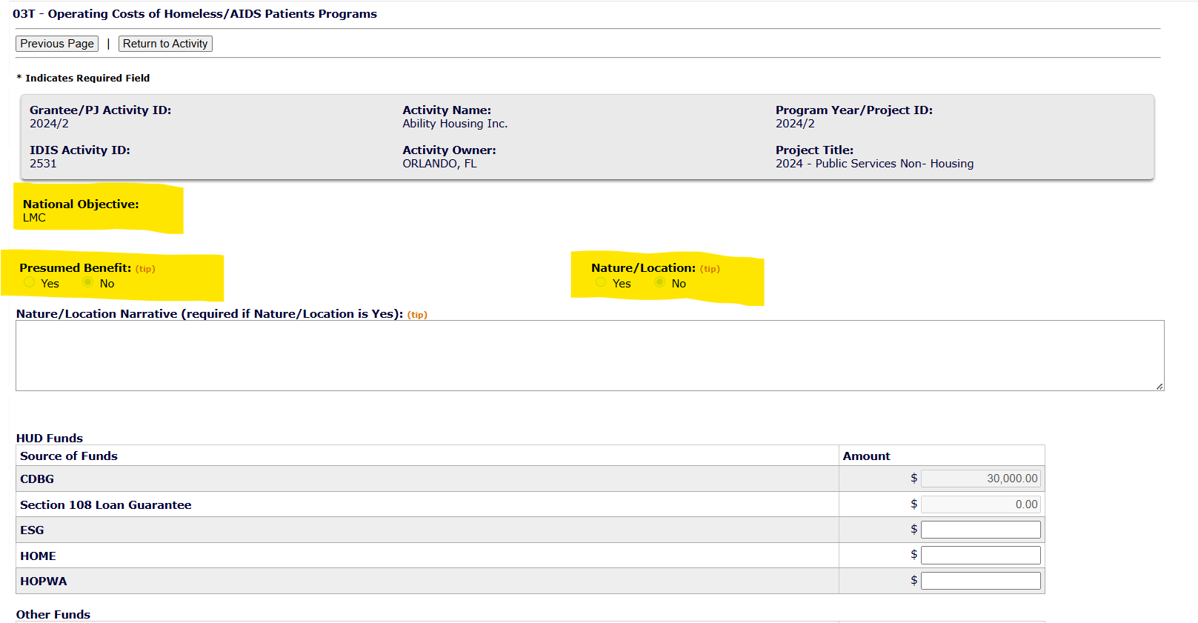
Limited Clientele

Slide 12
Documenting National Objective Compliance
We ensure our subrecipients are documenting their clients’ files by collecting intake forms and Policies and Procedures before the program starts and monitoring them during the Program Year
For all our Public Facility projects and new Public Services activities, we visit the site to verify need and how the facility is used

Slide 13
Documenting National Objective Compliance
Our staff certifies each funded activity for eligibility and National Objective annually at the time of assistance and as part of ongoing monitoring for Public Facility projects

Slide 14
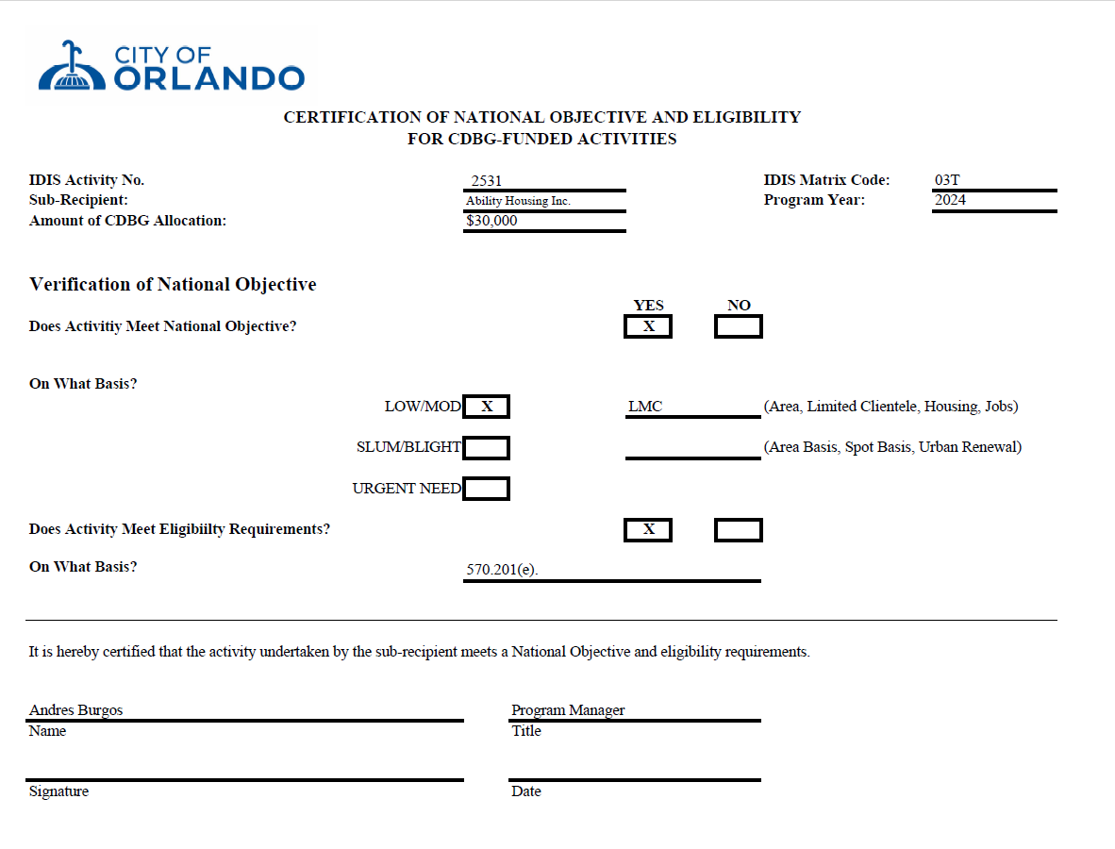
Certification

Slide 15
National Objective for CDBG-funded Public Facilities:
CDBG-funded public facilities must meet a National Objective for a minimum of five (5) years
After the activity is closed, we monitor the use of the Public Facility annually for at least four (4) additional years and document the file

Slide 16
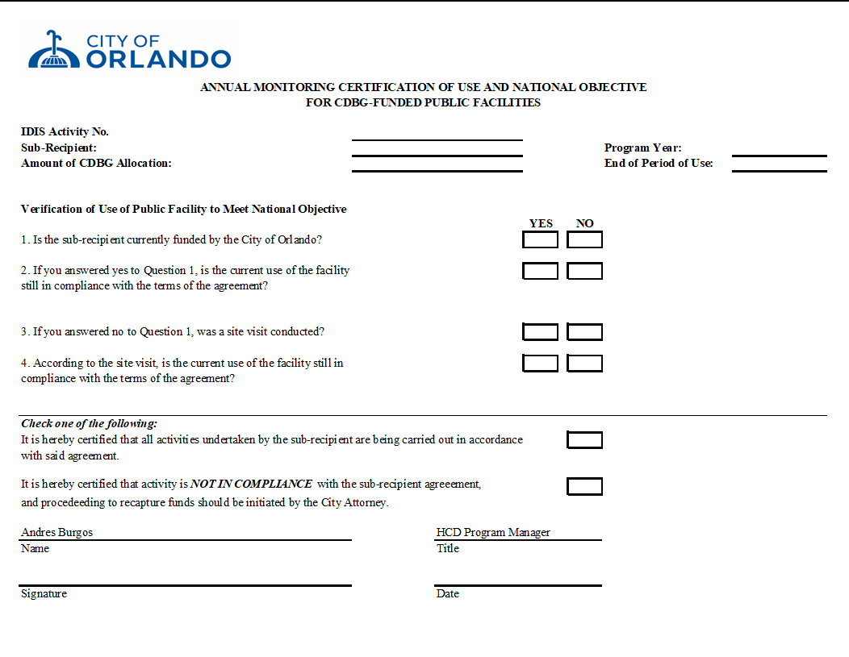
Annual Monitoring Certification

Slide 17
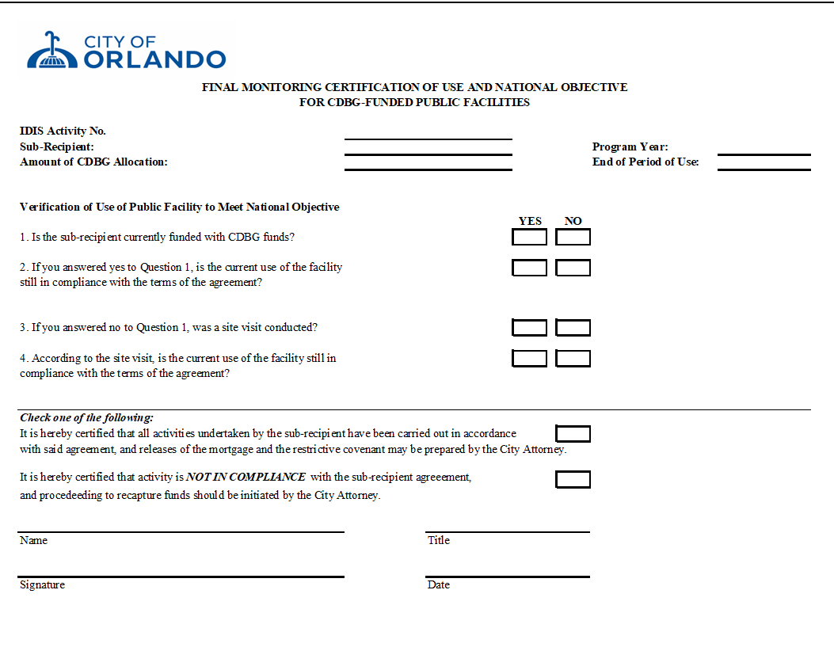
Final Monitoring Certification

Slide 18
Questions?
Sonia Carnaval
sonia.carnaval@orlando.gov
407.246.3326

